Slide 1
Database System
Lecture 10

Slide 2
SQL
SQL stands for Structured Query Language. It is used for storing and managing data in relational database management system (RDMS). In RDBMS data stored in the form of the tables.
It is a standard language for Relational Database System. It enables a user to create, read, update and delete relational databases and tables.
All the RDBMS like MySQL, Informix, Oracle, MS Access and SQL Server use SQL as their standard database language.
SQL allows users to query the database in a number of ways, using English-like statements.
SQL is mostly used by engineers in software development for data storage.

Slide 3
SQL Statement Rules
Structure query language is not case sensitive. Generally, keywords of SQL are written in uppercase.
Every SQL statements should ends with a semicolon.
Statements of SQL are dependent on text lines. We can use a single SQL statement on one or multiple text line.
Using the SQL statements, you can perform most of the actions in a database.
SQL depends on tuple relational calculus and relational algebra.

Slide 4
How does SQL process works:
When an SQL command is executing for any RDBMS, then the system figure out the best way to carry out the request and the SQL engine determines that how to interpret the task.
In the process, various components are included. These components can be optimization Engine, Query engine, Query dispatcher, classic, etc.
All the non-SQL queries are handled by the classic query engine, but SQL query engine won't handle logical files.

Slide 5
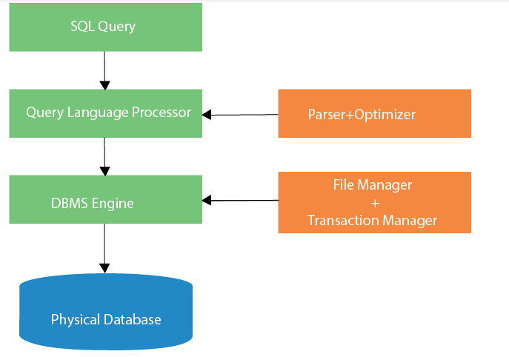

Slide 6
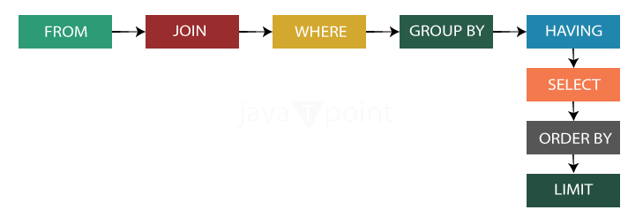
SQL Query Execution Order

Slide 7
In the previous diagrammatic representation following steps are performed:
Parsing: In this process, Query statement is tokenized.
Optimizing: In this process, SQL statement optimizes the best algorithm for byte code.
From: In SQL statement, from keyword is used to specify the tables from which data fetched.
Where: Where keyword works like conditional statement in SQL.
Join: A Join statement is used to combine data from more than one tables based on a common field among them.
Group by: It is used to group the fields by different records from table(s).
Having: Having clause is also works like conditional statement in SQL. It is mostly used with group by clause to filter the records.
Order by: This clause is used to sort the data in particular order by using "ASC" for ascending and "DESC" for descending order.
Select: This "Data Manipulation Language" statement is used to get the data from the database.
Limit: It is used to specify the how many rows returned by the SQL select statement.

Slide 8
Characteristics of SQL
SQL is easy to learn.
SQL is used to access data from relational database management systems.
SQL can execute queries against the database.
SQL is used to describe the data.
SQL is used to define the data in the database and manipulate it when needed.
SQL is used to create and drop the database and table.
SQL is used to create a view, stored procedure, function in a database.
SQL allows users to set permissions on tables, procedures, and views.

Slide 9
Advantages of SQL
There are the following advantages of SQL:
High speed: Using the SQL queries, the user can quickly and efficiently retrieve a large amount of records from a database.
No coding needed: In the standard SQL, it is very easy to manage the database system. It doesn't require a substantial amount of code to manage the database system.
Well defined standards: Long established are used by the SQL databases that are being used by ISO and ANSI.
Portability: SQL can be used in laptop, PCs, server and even some mobile phones.
Interactive language: SQL is a domain language used to communicate with the database. It is also used to receive answers to the complex questions in seconds.
Multiple data view: Using the SQL language, the users can make different views of the database structure.

Slide 10
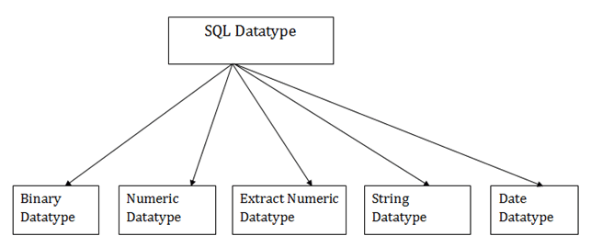
SQL Datatype
SQL Datatype is used to define the values that a column can contain.
Every column is required to have a name and data type in the database table.

Slide 11
1. Binary Datatypes
There are Three types of binary Datatypes which are given below:
Data Type | Description
binary | It has a maximum length of 8000 bytes. It contains fixed-length binary data.
varbinary | It has a maximum length of 8000 bytes. It contains variable-length binary data.
image | It has a maximum length of 2,147,483,647 bytes. It contains variable-length binary data.

Slide 12
2. Approximate Numeric Datatype :
The subtypes are given below:
Data type | From | To | Description
float | -1.79E + 308 | 1.79E + 308 | It is used to specify a floating-point value e.g. 6.2, 2.9 etc.
real | -3.40e + 38 | 3.40E + 38 | It specifies a single precision floating point number

Slide 13
3. Exact Numeric Datatype
The subtypes are given below:
Data type | Description
int | It is used to specify an integer value.
smallint | It is used to specify small integer value.
bit | It has the number of bits to store.
decimal | It specifies a numeric value that can have a decimal number.
numeric | It is used to specify a numeric value.

Slide 14
4. Character String Datatype
The subtypes are given below:
Data type | Description
char | It has a maximum length of 8000 characters. It contains Fixed-length non-unicode characters.
varchar | It has a maximum length of 8000 characters. It contains variable-length non-unicode characters.
text | It has a maximum length of 2,147,483,647 characters. It contains variable-length non-unicode characters.

Slide 15
5. Date and time Datatypes
The subtypes are given below:
Datatype | Description
date | It is used to store the year, month, and days value.
time | It is used to store the hour, minute, and second values.
timestamp | It stores the year, month, day, hour, minute, and the second value.

Slide 16
SQL Commands
SQL commands are instructions. It is used to communicate with the database. It is also used to perform specific tasks, functions, and queries of data.
SQL can perform various tasks like create a table, add data to tables, drop the table, modify the table, set permission for users.

Slide 17
Types of SQL Commands
There are four types of SQL commands: DDL, DML, DCL, TCL.
DDL | DML | DCL | TCL
Create Drop Alter Truncate Rename | Insert Update Delete Select | Grant Revoke | Commit Rollback Save Point

Slide 18
Data Definition Language (DDL)
DDL changes the structure of the table like creating a table, deleting a table, altering a table, etc.
All the command of DDL are auto-committed that means it permanently save all the changes in the database.
CREATE: It is used to create a new table in the database.
DROP: It is used to delete both the structure and record stored in the table.
ALTER: It is used to alter the structure of the database. This change could be either to modify the characteristics of an existing attribute or probably to add a new attribute.
TRUNCATE: It is used to delete all the rows from the table and free the space containing the table.
Rename: It is used to rename the table.

Slide 19
Data Manipulation Language
DML commands are used to modify the database. It is responsible for all form of changes in the database.
The command of DML is not auto-committed that means it can't permanently save all the changes in the database. They can be rollback.
INSERT: The INSERT statement is a SQL query. It is used to insert data into the row of a table. To insert a new row into a table you must be your on schema or INSERT privilege on the table.
UPDATE: This command is used to update or modify the value of a column in the table.
DELETE: It is used to remove one or more row from a table. To delete rows from the table, it must be in your schema or you must have delete privilege.
SELECT: This is the same as the projection operation of relational algebra. It is used to select the attribute based on the condition described by WHERE clause.

Slide 20
Data Control Language
DCL commands are used to grant and take back authority from any database user.
Grant: It is used to give permissions to the user for all DML command.
Revoke: It is used to take back permissions from the user.

Slide 21
Transaction Control Language
There are number of Transaction Control statements available that allow us to control this behavior. These statements ensure data consistency. TCL commands can only use with DML commands like INSERT, DELETE and UPDATE only.
Commit: Commit command is used to save all the transactions to the database. It makes your changes permanent and ends the transaction.
Rollback: Rollback command is used to undo transactions that have not already been saved to the database. Rollback also serves to end the current transaction and begin a new one.
SAVEPOINT: It is used to roll the transaction back to a certain point without rolling back the entire transaction.

Slide 22
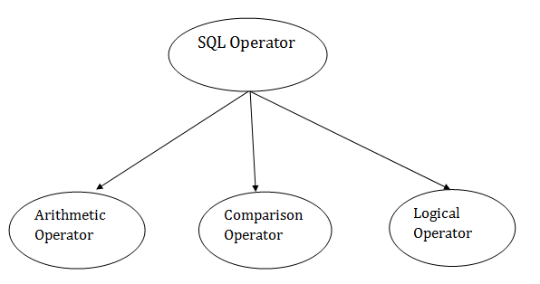
SQL Operator
There are various types of SQL operator:

Slide 23
SQL Arithmetic Operators
Operator | Description | Example
+ | It adds the value of both operands. | a+b will give 30
- | It is used to subtract the right-hand operand from the left-hand operand. | a-b will give 10
* | It is used to multiply the value of both operands. | a*b will give 200
/ | It is used to divide the left-hand operand by the right-hand operand. | a/b will give 2
% | It is used to divide the left-hand operand by the right-hand operand and returns reminder. | a%b will give 0

Slide 24
SQL Comparison Operators
Let's assume 'variable a' and 'variable b'. Here, 'a' contains 20 and 'b' contains 10.
Operator | Description | Example
= | It checks if two operands values are equal or not, if the values are equal then condition becomes true. | (a=b) is not true
!= | It checks if two operands values are equal or not, if values are not equal, then condition becomes true. | (a!=b) is true
<> | It checks if two operands values are equal or not, if values are not equal then condition becomes true. | (a<>b) is true
> | It checks if the left operand value is greater than right operand value, if yes then condition becomes true. | (a>b) is not true
< | It checks if the left operand value is less than right operand value, if yes then condition becomes true. | (a<b) is true

Slide 25
SQL Comparison Operators (cont.)
Operator | Description | Example
>= | It checks if the left operand value is greater than or equal to the right operand value, if yes then condition becomes true. | (a>=b) is not true
<= | It checks if the left operand value is less than or equal to the right operand value, if yes then condition becomes true. | (a<=b) is true
!< | It checks if the left operand value is not less than the right operand value, if yes then condition becomes true. | (a!=b) is not true
!> | It checks if the left operand value is not greater than the right operand value, if yes then condition becomes true. | (a!>b) is true

Slide 26
SQL Logical Operators
There is the list of logical operator used in SQL:
Operator | Description
ALL | It compares a value to all values in another value set.
AND | It allows the existence of multiple conditions in an SQL statement.
ANY | It compares the values in the list according to the condition.
BETWEEN | It is used to search for values that are within a set of values.
IN | It compares a value to that specified list value.
NOT | It reverses the meaning of any logical operator.
OR | It combines multiple conditions in SQL statements.
EXISTS | It is used to search for the presence of a row in a specified table.
LIKE | It compares a value to similar values using wildcard operator.

